Slide 1


Augmented Reality in Real Estate
Augmented reality (AR) is transforming the real estate industry. It offers innovative ways to engage buyers and streamline processes.
by GUNDU CHARAN SAI

Slide 2
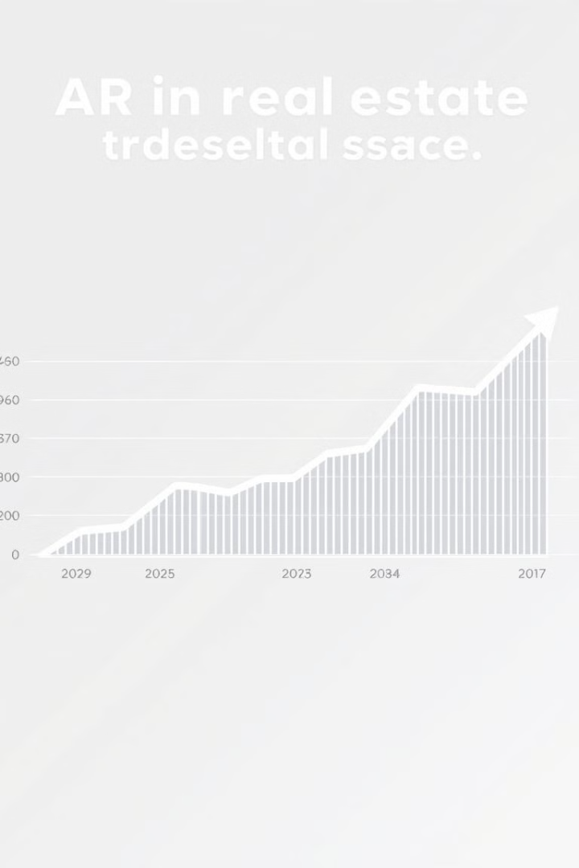
The Rise of AR in the Real Estate Industry
1
Early Adoption
Initial experiments with AR in virtual tours.
2
Mainstream Use
Integration into apps and marketing materials.
3
Future Potential
AR glasses and immersive experiences.

Slide 3

Enhancing the Home Viewing Experience
Virtual Staging
Interactive Tours
Furnishing empty properties to visualize potential.
Exploring properties remotely with detailed information.
Measurements & Dimensions
Overlaying precise measurements onto the real-world view.

Slide 4
Visualizing Renovations and Home Design
Before
After
Process
Original kitchen layout and design.
AR visualization of the renovated kitchen.
Steps involved in the renovation.

Slide 5
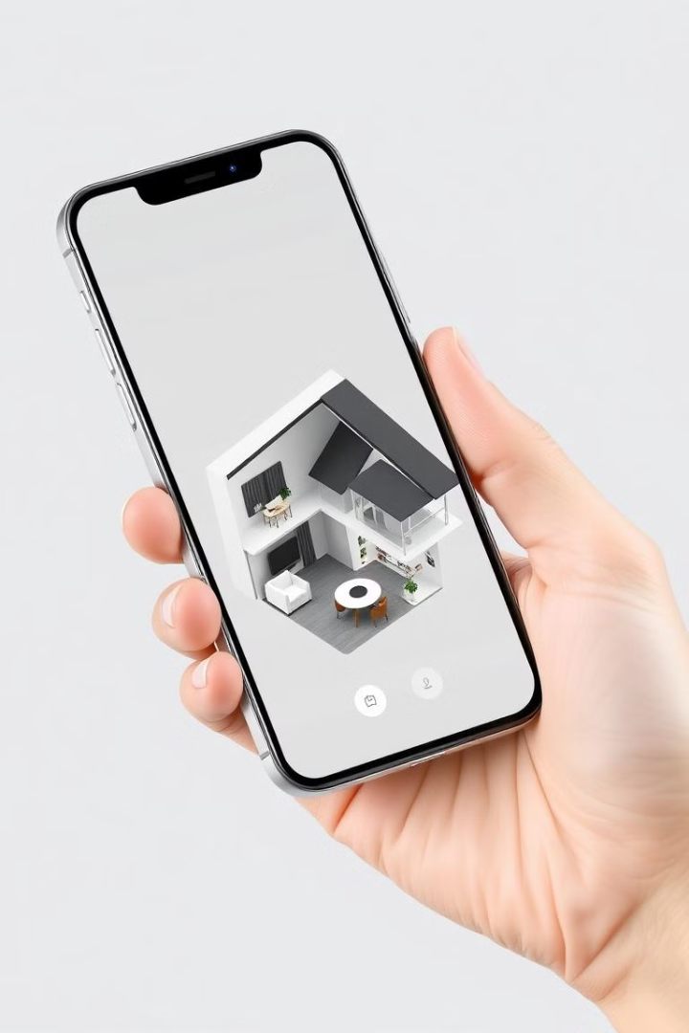



Interactive Property Listings and Walkthroughs
3D Model
Interactive exploration of a property.
Annotations
Adding information about property features.
Virtual Walkthrough
Immersive exploration of each room.

Slide 6
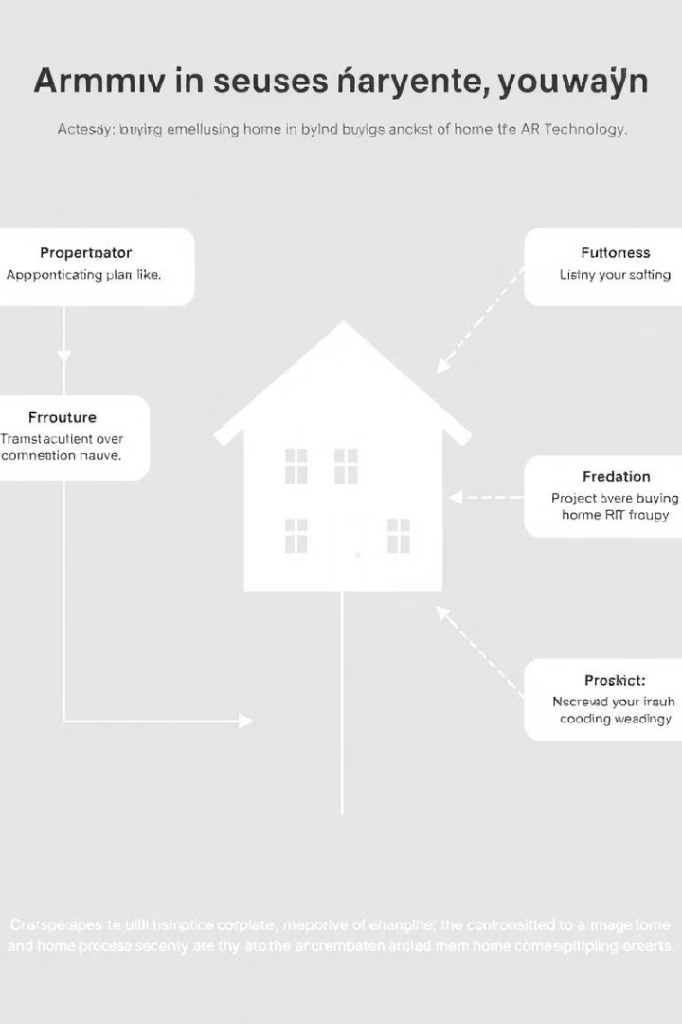
Streamlining the Home Buying Process
1
Faster Searches
2
Reduced Travel
Quickly finding properties matching needs.
Remote viewing eliminates unnecessary travel.
3
Informed Decisions
Detailed information and immersive experiences.

Slide 7




Immersive Open House Experiences
Virtual Tours
Explore properties remotely.
Location Data
Access information effortlessly.
Interactive Sessions
Engage with agents and other buyers.

Slide 8

Leveraging AR for Real Estate Marketing
Method
Benefit
Virtual Tours
Increased engagement
Interactive Ads
Higher click-through rates
Social Media
Improved brand visibility

Slide 9


The Future of AR in Real Estate
AR Glasses
AI Integration
Hands-free property exploration.
Personalized assistance and information.

Slide 10

Conclusion: Embracing the AR Revolution
AR is revolutionizing real estate. It offers enhanced experiences, efficiency, and engagement. Embracing this technology is crucial for success.

